Slide 1
E-GENI Clearinghouse
Jad Naous, Srini Seetharaman, Rob Sherwood, Guido Appenzeller, Guru Parulkar, Nick McKeown

Slide 2
Outline
GENI in a nutshell
Enterprise GENI in a nutshell
Clearinghouse

Slide 3
GENI – Global Environment for Network Innovations
Global distributed systems lab
Programmability across the stack
Heterogeneous

Slide 4
Enterprise GENI
Stanford’s contribution
OpenFlow as a programmable network substrate
Integration and cross-aggregate stitching

Slide 5

Overview
Clearinghouse
Other
Aggregate Manager
OpenFlow
Aggregate Manager
PlanetLab
Aggregate Manager
Other
Aggregate
OpenFlow Aggregate
PlanetLab Aggregate

Slide 6
Overview
Clearinghouse
Other
Aggregate Manager
OpenFlow
Aggregate Manager
PlanetLab
Aggregate Manager
Other
Aggregate
OpenFlow Aggregate
PlanetLab Aggregate

Slide 7
Overview
Clearinghouse
Other
Aggregate Manager
OpenFlow
Aggregate Manager
PlanetLab
Aggregate Manager
Other
Aggregate
OpenFlow Aggregate
PlanetLab Aggregate

Slide 8
Overview
Clearinghouse
Other
Aggregate Manager
OpenFlow
Aggregate Manager
PlanetLab
Aggregate Manager
Other
Aggregate
OpenFlow Aggregate
PlanetLab Aggregate

Slide 9
Clearinghouse
Authentication
Aggregation
Reservations

Slide 10
Our Clearinghouse
Web application using Django
Reservations across OpenFlow and PlanetLab

Slide 11
Quick Demo of Slice Reservation

Slide 12
Problems/Issues
Handling Heterogeneity
Simplifying authentication and authorization
Designing useable user interfaces
Abstracting resource models

Slide 13
Next Clearinghouse
GUI
API
ns2
ns32
…
Users, Slices, Resources
Open
Flow
PlanetLab
Emu
Lab
…

Slide 14
Thank You!
Questions?

Slide 15
Backups

Slide 16
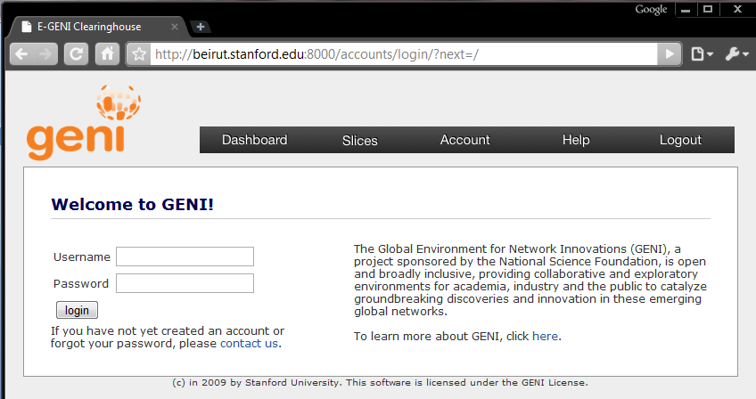
Clearinghouse

Slide 17
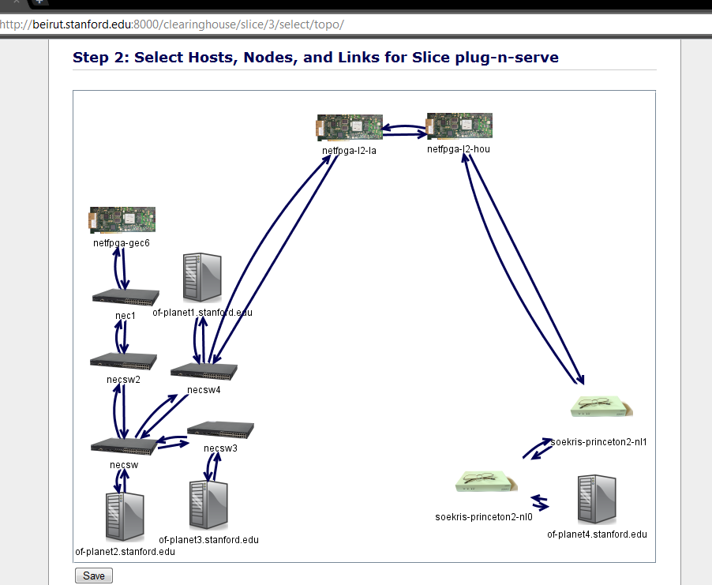
Clearinghouse

